Slide 1

Troubleshooting & Advanced Administration with System Center 2012 SP1 Orchestrator Andreas Rynes Datacenter Architect Microsoft Corporation
Microsoft Virtual Academy
Notes:
Welcome to this session about Orchestrator and it is called Troubleshooting & Advanced Administration with System Center 2012 SP1 Orchestrator. My name is Andreas Rynes. I am a Datacenter Architect at Microsoft.

Slide 2
Objectives
Discuss advanced administrative topics related to SCO
Understand how to adjust logging levels in SCO and troubleshoot common scenarios
Notes:
Today I would like to discuss the advanced administrative topics that are related to Orchestrator and I would like to give you also an idea about the ways of how to troubleshoot and how to log information and errors that occur in Orchestrator and to understand how to troubleshoot those scenarios.
Objectives
Start Time 00:01 / Length: 1 minute
Microsoft Lync tools used on this page:
None
Review the learning objectives.

Slide 3
Agenda
Runbook Throttling
Self-Monitoring
Audit Trail
Product Footprint
SCO Folder Structure
SCO Registry Keys
Logging Information
Basic Troubleshooting
Notes:
The agenda will be that we first start talking a little bit about runbook throttling and what does that mean and how to use that. Then, about self-monitoring and how does Orchestrator support that and then how to use and enable audit trail. Then we will go a little bit into the details of Orchestrator folder structure and registry keys and talk a little bit about the footprint of the product itself and then what logging information is available and how to configure those and some sort of basic troubleshooting at the very end of that session.
IPv6 Subnet and Address Planning
Start Time 00:04 / Length: 3 minutes
Microsoft Lync tools used on this page:
None
Take the students through the subnet and address plan. Explain the various stages of how the plan comes together.

Slide 4

Runbook - Run Behavior
Runbook Run Behavior can be configured in the Runbook Properties, Run Behavior tab
The “Maximum number of simultaneous jobs” field is used to set the number of parallel executions allowed for the runbook
Limitations of Parallel Execution
Any runbook that begins with a Monitor object will not be able to run in multiple, simultaneous requests
Any runbook that contains an object which is configured to modify a resource which can become locked or does not accept simultaneous updates should be restricted to single execution.
Some external systems (tools or ticketing systems) may not support parallel execution
Notes:
First of all, runbook and the behavior of runbooks.
With every runbook you are able to define some sort of behavior on the properties tab of the runbook itself so there is a tab called run behavior and there you can define the maximum number of simultaneous jobs so there is a textbook where you can set the number of parallel executions that are allowed for the runbook and that really depends, of course, on the runbook itself. For example, if you are going to modify a resource that can become locked or does not accept simultaneous updates, for example, then you should restrict that for single executions and then you enter 1 to that field, to that textbox of the run behavior tab.
Another limitation here is if your runbook is using a monitor object than you will not be able to run that multiple times so you have to limit that to a single execution as well and, of course, some external systems do not support parallel executions as well. From those limits you are able to really define a number of parallel executions yourself. There is also a very good blogs out there on the Orchestrator blog which is on blogs.technet.com/orchestrator where you will find a very detailed description of how parallel execution is working in Orchestrator.

Slide 5
Runbook Throttling
Each Runbook Server can be configured to limit the number of runbooks it can run concurrently
Default is 50 runbooks per Runbook Server
The Limit can be adjusted using the Runbook Server Policy Throttle command (aspt.exe <RunbookServerName> <MaxRunPolicies>)
Considerations before adjusting the default
Are there many runbooks running on the Runbook Server, or only a few?
Do these runbooks run frequently, or infrequently?
Do these runbooks require a lot of resources to run?
Do the runbooks include a few steps in each workflow, or many steps?
Notes:
Another important topic when it comes to administrative topics about Orchestrator is runbook throttling. The default value for that is that is that every runbook server can run 50 runbooks at the same time. This is the default value for that, but of course you can configure that to a different number of runbooks that it can run currently and that has to be done using the command line aspt.exe with 2 parameters, the runbook server name and the maximum number of runbooks that you would like to define for that runbook server and then, of course, you can set that to a lower or higher number of runbooks per runbooks server. Just consider a couple of things and think about it first before you are going to set that.
First of all, how often are you going to use that runbook? Is that a very frequent number or is it very infrequent? How much resources does this runbook require so if it has a lot of resources in there and if it has really high requirements on that than you probably would like to lower that number from 50 to some lower number. If it does not have a big requirement on resources and it runs very infrequently you might think about adding more runbooks that can be done concurrently on the runbook server. And, of course, also think about how many runbooks are there on the runbook server. Is there just 1 runbook? Or are there 20 different runbooks? And how many steps are involved in each runbook? and those are the things that you have to think about before changing that default from 50 to something else.

Slide 6
Self-Monitoring
Monitors several aspects of SCO functionality
Runbooks, Objects, Database Connections
Controlled through “Orchestrator Runbook Server Monitor”
Events are not sent when service is not running
Notifications not sent on events that occurred while service is down
Events Reported by Self Monitoring
Runbooks have started but are not running
Runbooks start, run, and do not restart
A runbook is published two or more times
An runbook server cannot connect to the datastore
Frequent errors connecting to or writing to the datastore
An runbook server has stopped running
Runbook server is reaching the runbook throttling limit
Notes:
Another important and quite interesting aspect of Orchestrator is the self-monitoring topic. Orchestrator has functionality that monitors itself for runbooks and for different objects and also for the database and that is done by a service called Orchestrator Runbook Server Monitor which you will find in your list of services on your windows server and if that is not running you will not see any events, of course, and no notification will happen, but as soon as that Orchestrator to runbook server monitor is running it will write events to your event log about runbooks that have started or not started or about a runbook that cannot connect to the datastore, for example, so if there is any connectivity issue with the Orchestrator database this self-monitoring functionality of Orchestrator will help you to identify those problems in the event log. Of course, if there is any frequent error happening while connecting or writing to the datastore that will also trigger an event. If a runbook server, for example, has stopped running that is also interesting from an administration perspective. It will trigger an event there as well and also if the runbook server is reaching the runbook throttling limit, which we discussed the slide before then, again, the Orchestrator runbook service monitor will trigger an event and will write that information to the event log.

Slide 7

SCO Folder Structure
The default directory structure is shown here (for 64-bit system)
Monitor disk space on SCO install directory if you have logging levels and retention turned up above product defaults
Program Files (x86)
Microsoft System Center 2012
Orchestrator
Management Server
Orchestration Console
Runbook Designer
Runbook Server
Web Service
Notes:
When it comes to the Folder Structure of Orchestrator if you look on the default directory structure on the right you will see a couple of different folders within the Orchestrator folder which has a management server folder, orchestration console folder, runbook designer folder, runbook server folder and web service folder with all the binaries and executables there as well. This is all about the folder structure of Orchestrator.

Slide 8
SCO Registry Structure
Registry structure varies based on OS architecture (32-bit or 64-bit)
32-bit: HKLM\SOFTWARE\Microsoft\SystemCenter2012\Orchestrator
64-bit: HKLM\SOFTWARE\Wow6432Node\Microsoft\SystemCenter2012\Orchestrator
[HKLM\SOFTWARE\[…]\Orchestrator\]
Runbook Server - Settings for the Runbook Server role
Runbook Designer – Settings for Designer
IPs – Contains a list of installed Integration Packs
Orchestrator Console – Settings for Orchestrator Server
Management Server – Settings for the Management Server role
TraceLogger – Contains role-specific subkeys for enabling trace logging
Notes:
When it comes to the registry structure you will find a registry that depends on the architecture of the operating system, of course so either a 32 or a 64-bit. The keys are in a different location, of course, but they are in the local machine key under software and then depending on the architecture of the operating system you will find them in different folders there. For each element or component of Orchestrator you will find a different registry key. For runbook server you have the settings for all the runbook server role. For the designer you will find them under the runbook designer folder. Then, for the integration packs that will contain a list of all installed and registered integration packs and also for Orchestrator console and management server you have all the settings there for those components of Orchestrator as well. The last one is the TraceLogger and I will talk about that a little bit later where you will find role-specific subkeys for the different components and where you are able to configure tracelogging and also enable and disable tracelogging as well. This will be covered in a second as well as when we talk about logging perspective about Orchestrator.

Slide 9
Audit Trail
The Audit Trail is a log containing information about runbook execution (who or what triggered the runbook and runtime details)
A new log is created every 200 mb
Name contains unique date / time stamp
Not activated by default
Location: %LocalAppData%\Microsoft System Center 2012\Orchestrator
Records the following information
Who or what started the runbook
Date and time at which the runbook started
Computer on which runbook ran
Configuration data from each object in running runbooks
Notes:
Another feature is Audit Trail and this is really giving you the option to report on changes in the configuration and to have that information available for audits and actually it is a collection of tax log files that are stored in your file system and it contains information about any interaction of a runbook with an external tool or system so whenever there is a change of configuration or a changed compliance of processes, for example, this will be stored in that tax log file, but it is very important to note that depending on how many runbooks you have and how often they are invoked and how many activities are in those runbooks that the audit trail function can really consume a large amount of disc space so be aware of that and do not activate that just to see what happens. It is only if you really to have and use that feature and you know what to do. That is the reason it is not activated by default.
Really, it records a lot of good information. You will find information about who and what started the runbooks, for example, at which time and which date the runbook was started, which is the computer that the runbook ran on, what is the configuration data of each activity and each object in a given runbook. You will find all this information in the Microsoft Systems Center 2012 folder below Orchestrator you will find the log files there and have all that information. To activate that actually there is in the management server folder on your file system you will find a command line tool that is called ATLC and with that you are able, with a /enable and /disable, you are able to activate that audit trail or deactivate it again.

Slide 10
Log File Names & Locations
Folder Path | File Name | Description
%LocalAppData%\Microsoft System Center 2012\Orchestrator | [GUID]*.log | Exceptions generated by the runbook server service (connection errors, etc) are logged here
 | RunbookDesigner.log | Log of client launch capturing configuration state at the time of launch (computer name, user name, etc)
 | [GUID]*.log | Contains exceptions generated by the action server. This log is useful for finding environmental problems (e.g. database connect failures)
 | SetupOrchestrator.log SetupWizard.log | Installations of action servers, foundation objects, and integration packs (reflected msi logs)
 | oismc*.log | Deployments of action servers, clients, and integration packs
 | WebCompontentsMSI.log | Log of operator console service for start up and operation.
Notes:
Getting back to the log files, as I mentioned before, there are a couple of different log files. First of all, you have log files for every different component of your Orchestrator environment which you can enable and configure in the registry. I am coming back to that in a second. Then you have different files for runbook designer, for the setup of Orchestrator , for the web components, so there are really a lot of different log files available in the Orchestrator filled with your file system and the most important one is used by runbook, but a runbook server as well as for the problems that are happening to you and why. For example, if you have database connection for yours, for example, you will find the log files there as well and they are using a GUID to name those log files.

Slide 11
Setting / Collecting Debug Logs
Trace Logging can be enabled in the registry
HKEY_LOCAL_MACHINE\SOFTWARE\Wow6432Node\Microsoft\SystemCenter2012\Orchestrator\TraceLogger
"LogFolder"="C:\\Program Files\\Logs"
"LogLevel"="1"
"LogPrefix"=“OrchestratorManagementService"
"Keep"="100"
"NewLogEvery"="3600"
NOTE: Each SCO component has it’s own subkey and LogLevel setting below the \TraceLogger key.
To enable trace logging, adjust “LogLevel”
LogLevel 1 is the Default. This only contains exception detail
LogLevel 3 includes exception detail with errors and warnings
LogLevel 7 is the most verbose trace logging available
Notes:
Where are you going to configure and enable those logs? Back to the registry I mentioned before, you are able for every component in Orchestrator to define the logging options. If you go to the local machine registry key, down to the Orchestrator key you will find a key called TraceLogger and below that you will have a subkey for each Orchestrator component so you will find one, for example, for Management Service. You will find one the runbooks and activities and so on and for those you are able to define a couple of options here like the log folder where you would like to store the logs to. Then, you are able to define the log label that actually defines the level of details. Depending on the number here, there are a couple of options:
Number 1 is actually the lowest number and the lowest amount of information that will be stored in the logs so those are only exceptions that will be logged in the log files.
Number 3 gives you exceptions with warnings and arrows.
Number 7 is actually the highest number that will give you really a full logging of that specific Orchestrator component. Then you have the new log entry and this tells you the number of seconds when a new file log will be created. Again, think of the disc space that will be used and use it carefully, but this really gives you a lot of information about what is going on for a specific Orchestrator component and, of course, you can enable that and configure that for every component within your Orchestrator environment.

Slide 12
Basic Troubleshooting
Every runbook generates a log when it is running
SCO enables you to view real-time and historical logs of runbook execution
Double-click an object in the log to view the result of the execution of that object
Configure Runbook Logging Options
Add entries for object-generated or common Published Data items
Use the Orchestrator Console to observe runbook execution in real-time
By default only basic runbook and object logging is available
To enable “verbose” logging, check the boxes for both Common and Activity-specific Published Data in the Logging Tab of each Runbook
Notes:
How to do some basic troubleshooting.
The first option you have is that every runbook generates a log when it is running so if you go to the designer on the very bottom you will find 2 different logs. First is a real time log where you will see what runbook actually is running and what activities are currently running and what information is there.
Then you have a second tab that has the historical logs of your runbook execution so it tells you which runbook was run before. Was it successful? Was it failed? What are the activities that were used? Which are the published data in ever instance of your runbook so there is a lot of information there that helps you to troubleshoot your runbook and, of course, you can double click on those objects to get more and more information in that designer.
Then, of course, you can configure runbook logging options. You can use the common published data items which are there out of the box for every activity and again, those options that I mentioned before about logging levels that helps you to really get information on activity specific and common published data in the logging tab of each runbook as well. You are able to enable that logging here as well.
I would really recommend you using the real time and historical logs so if you go to your runbook on the very bottom you have that information. You have those 2 tabs that will give you a lot of information about what is going on currently and what is going on in the past and most of the time that is my experience. You will find the problems with the runbook, with the specific runbook there from the real time and especially from the historical logs so if you double click on a specific instance it will open up that instance and shows you all the activities that were used. Which one was successful, which one failed and if you double click on the failed one it will give you more information about the published data that is there, both common and activity-specific published data and from there you normally will find the problems, if you have one, with one of your runbooks. That is my recommendation for troubleshooting runbooks.

Slide 13
Demo
Notes:
Now lets switch back to the Orchestrator designer and I would like to show you a couple of troubleshooting tricks and recommendations for your runbooks and your Orchestrator environment.
Now we are in the runbook designer and I am going to reuse one of the runbooks that I showed you in 1 of my earlier presentations about Orchestrator 2012 and I think that was part of the complex workflow concepts. This 1 is actually a runbook that is query databases, calling web services, query XML responses and so on, but I am going to reuse that just to show you some basic troubleshooting tips.
If we go to run this now, at the bottom you have the designer you have 2 tabs, 1 is the log tab which gives you real time information about currently running instances of your runbook so you can open it up and see what activity is currently running and with log history you have all the past instances that were running so if you click on 1 of those you see that happened only a few minutes ago. You see when it was started, you see the end time of that instance and the status of that specified instance here.
If you double click that here you see all the activities and that will match to the activities here in the design pane of the runbook designer. Of course, you can double click on every activity within that instance and you have all the published information so there is some common published data, for example, so start and date/time, stuff like that, but you also have published data that is specific to that activity so, for example, if we go back, that was the monitored date/time activity, but if we go to the invoke web service you will see a couple of common stuff, but you will also see the XML request payload published data which was used and the value down here, in this case we have used Alice Springs in Australia , as the published data as the value for the SML request payload variable and that is 1 variable that is really specific to the invoke web surface activity you won’t find in the query database, for example, so if you click on the query database you have stuff like the database server, for example, which was SQL01 and stuff like that.
That is really very powerful to identify problems, but now everything is fine so we want to create some problems so we are going to stop that guy, check it out to make some changes to the runbook, go to the invoke web service and just change the URL of that VSDL file and add some strange number to it so that is not working here so we check in that guy so we have the wrong URL for the invoke web service so we are going to run that runbook again. Now, this entry here in the log history just showed you a failed one and that was the one when I pressed the stop button and then it will, wherever that was, at the monitor date/time that will say it failed because someone pressed the stop button, but now we have one that is currently running with the changes in the invoke web service so that with the changed URL. If we go to the log history you see that we have 1 in here and the first 2 activities succeeded so those are successful, but the invoke web services failed so if we click on that we have an error summary text that says it cannot create the web service proxy assembly and so on so you have information specific to which instance of your runbook failed and which activity it failed and in this case it was the invoke web service.
Those are some basic tips and recommendations on how to trouble shoot your runbooks.

Slide 14
Summary
Understand log locations and logging levels in SCO
Review of runbook throttling
Maximum concurrent runbook thresholds per runbook server
Decision process for changing these defaults
Basic troubleshooting methodology
Notes:
We are already at the summary so I hope I gave you some information and understanding about the way of how logging is working with Orchestrator and what are the different logging levels, how to configure that and then, of course, how to do runbook throttling. Think about what is going on on your runbook server and how many runbooks are working there. Is that resource intensive or not? Based on those considerations define or set the value for runbook throttling if the default value is not working for you. And, of course, the last slide where we talked about some troubleshooting ideas and how to work with the real time and historic logging tab.

Slide 15
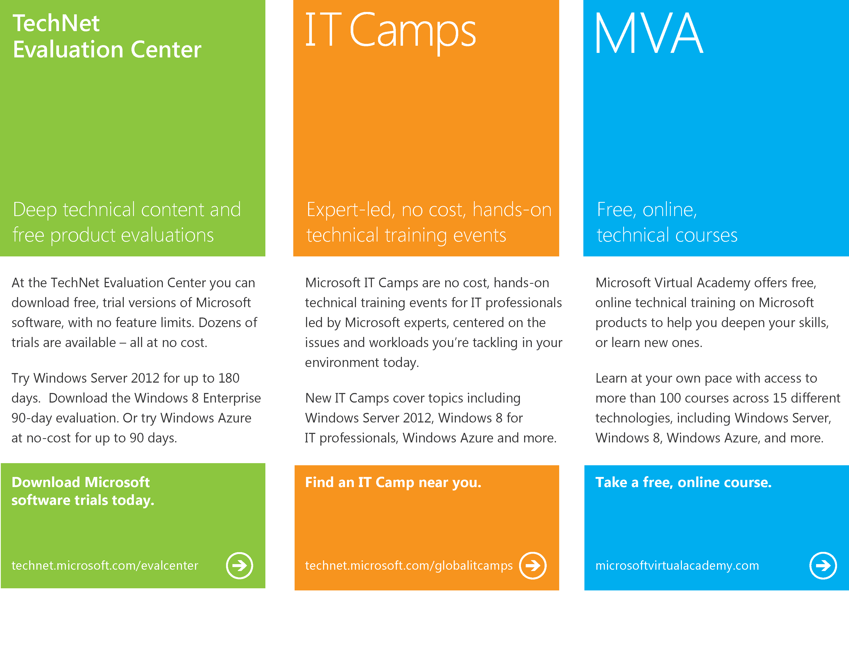
Notes:
With that, I would like to highlight some more information. With the TechNet Evaluation Center you are able to download free trial versions of Microsoft software that is on technet.microsoft.com/evalcenter. Then you have the IT Camps website which gives you technical training events for IT pros which is on technet.microsoft.com/globalitcamps and last, but not least, the free online technical trainings on Microsoft products at microsoftvirtualacademy.com.

Slide 16

© 2012 Microsoft Corporation. All rights reserved. Microsoft, Windows, Windows Vista and other product names are or may be registered trademarks and/or trademarks in the U.S. and/or other countries.
The information herein is for informational purposes only and represents the current view of Microsoft Corporation as of the date of this presentation. Because Microsoft must respond to changing market conditions, it should not be interpreted to be a commitment on the part of Microsoft, and Microsoft cannot guarantee the accuracy of any information provided after the date of this presentation. MICROSOFT MAKES NO WARRANTIES, EXPRESS, IMPLIED OR STATUTORY, AS TO THE INFORMATION IN THIS PRESENTATION.
Notes:
With that, thank you very much for this session and for your time and hope to see you soon on another session of Orchestrator 2012. Thank you.

